Slide 1
Effects of Varying Noise in High Conductance Cases

Slide 2
GOAL
High inhibitory conductance cases have depreciating maximum somatic frequency outputs in the FS curves and results in curvy FI curves (i.e. more inhibitory conductance results in lower maximum APs). The goal is to see if adding a noisy current will change the shape of the FI curve and see if there is an impact on the overall firing rate

Slide 3
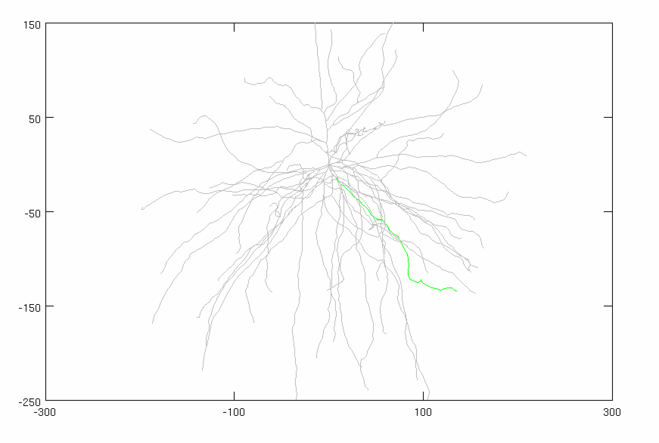
Parameters
Inhibitory Gamma
N_syn = 30 (ON SOMA)
Firing rate: 50 Hz
Distribution: 3 ms
Conductance: 0.01 µS
Adjusted Current
Amplitude: VARIABLE
Noise: VARIABLE
Stimulus
Total synapses: 40 synapses
AMPA: 0.0015 µS
NMDA: 0.0039 µS
Firing rate: 50 Hz
Start Time: 5 ms
Noise: 0 ms
Location: 50% of the dendrite (focal, synchronized))
AVG: 15 trials
CONSTANT
VARIABLE
CONSTANT

Slide 4
Case 1: Control (No Noise)
Inhib Gamma
N_syn = 30
Firing rate: 50 Hz
Distribution: 3 ms
Conductance: 0.01 µS
Current Amplitude: 2.52 nA
Current Noise (Variance): 0 nA²
Current STD: 0 nA

Slide 5
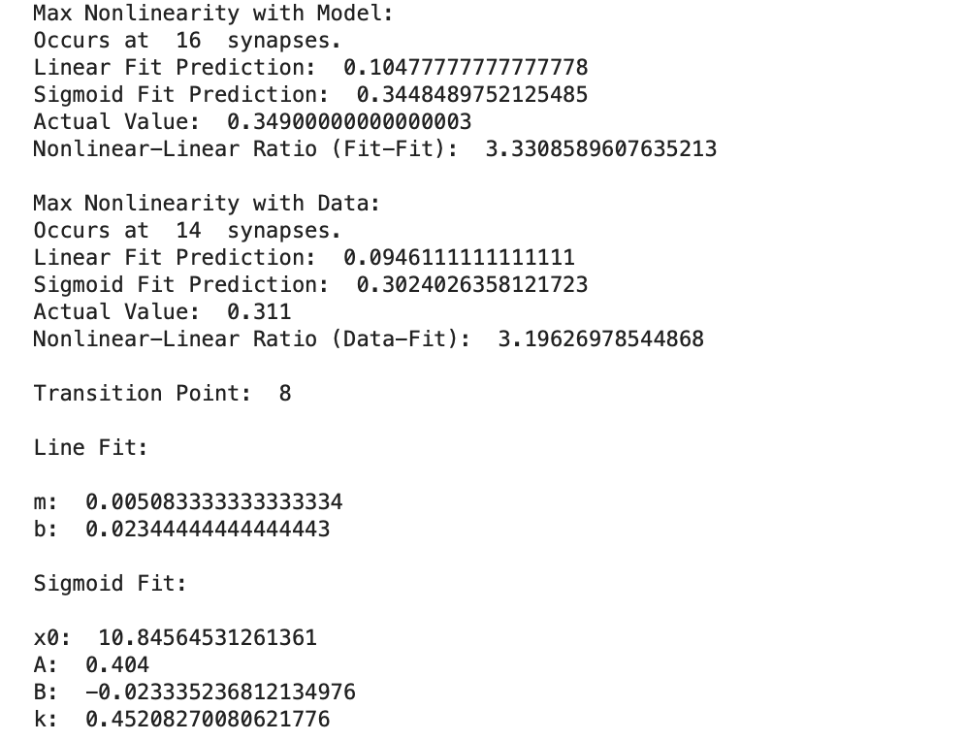
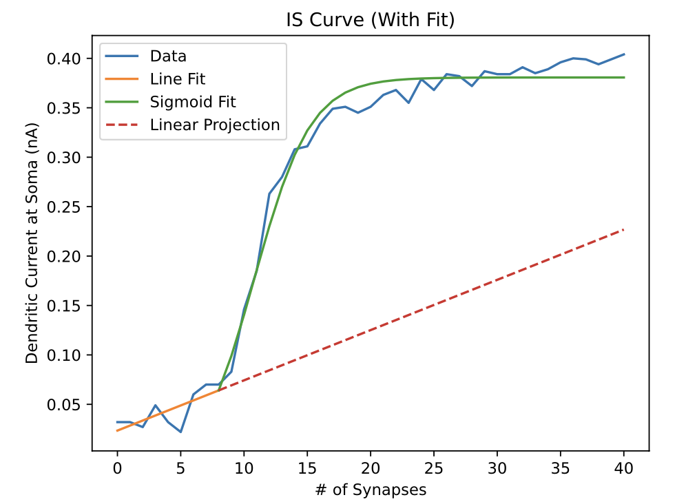
Case 1: Control (No Noise)
Current Amplitude: 2.52 nA
Current Noise (Variance): 0 nA²
Current STD: 0 nA

Slide 6
Case 2: Variance: 1 nA²
Current Amplitude: 2.42 nA
Current Noise (Variance): 1 nA²
Current STD: 1 nA

Slide 7
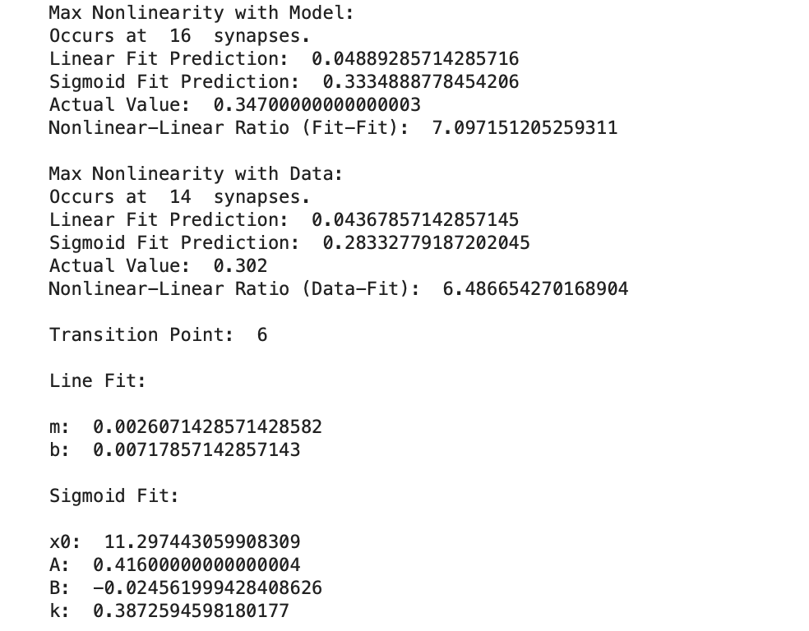
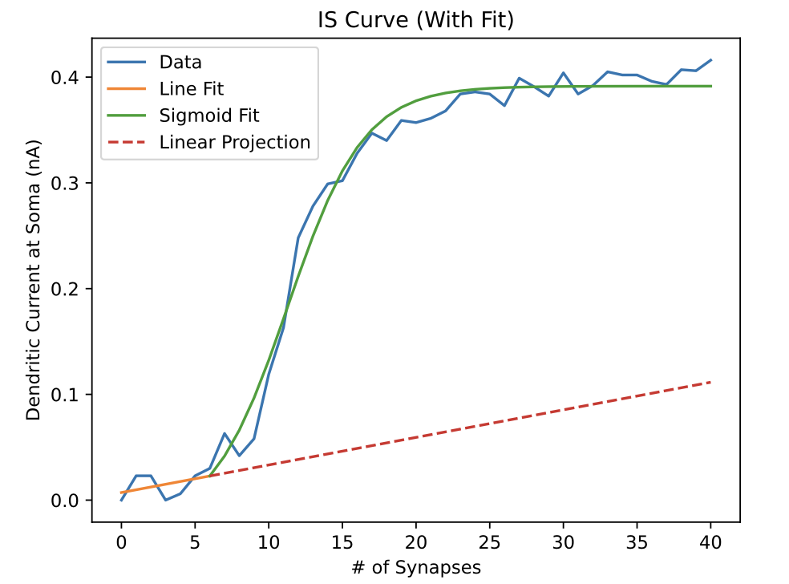
Case 2: Variance: 1 nA²
Current Amplitude: 2.42 nA
Current Noise (Variance): 1 nA²
Current STD: 1 nA

Slide 8
Case 3: Variance: 2 nA²
Current Amplitude: 2.28 nA
Current Noise (Variance): 2 nA²
Current STD: 1.414 nA

Slide 9
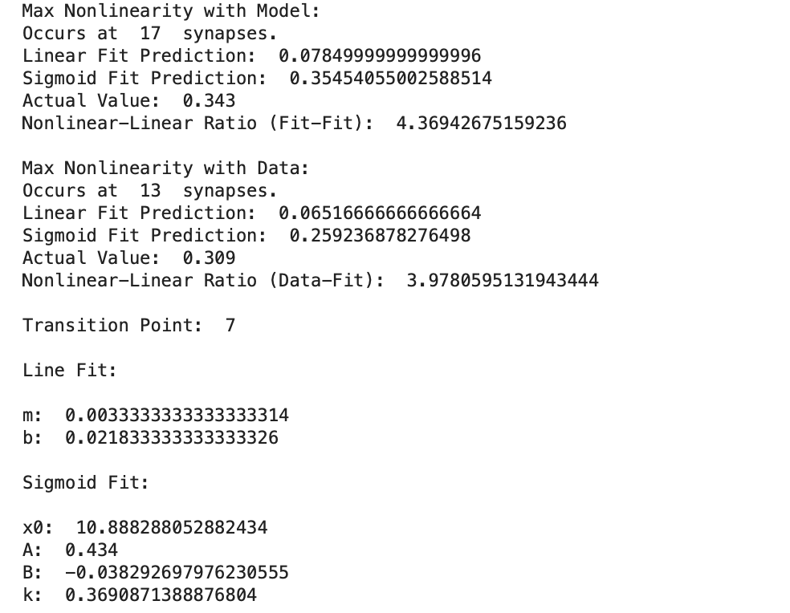
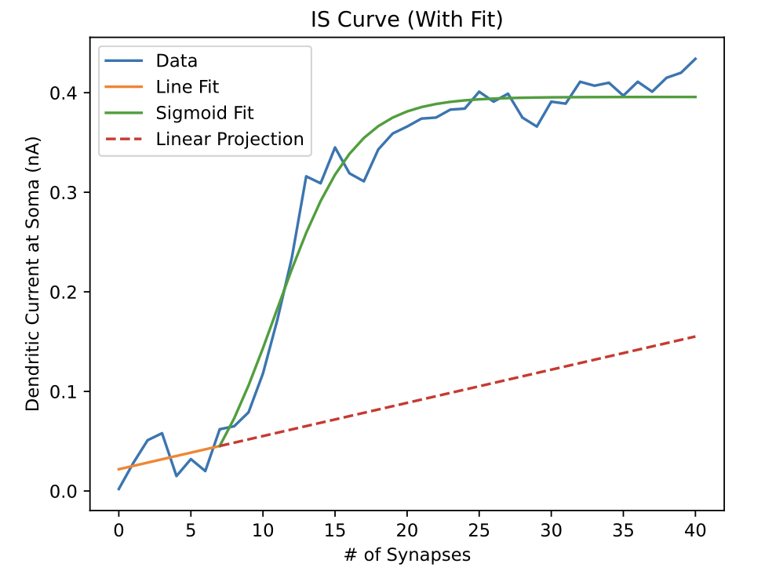
Case 3: Variance: 2 nA²
Current Amplitude: 2.28 nA
Current Noise (Variance): 2 nA²
Current STD: 1.414 nA

Slide 10
Compiled Cases

Slide 11
Compiled Cases

